Slide 1
Using Pivot Tables For Employee Turnover Analysis
STUDENT NAME: SANGAVI.V
REGISTER NO:312217049(asunm1659312217040)
DEPARTMENT: B.COM(GENERAL)
COLLEGE: SHRI KRISHNASWAMY COLLEGE FOR WOMEN

Slide 2
PROJECT TITLE
Using Pivot Tables For Employee Turnover Analysis
Summary:
Pivot tables are an effective tool for analyzing employee turnover. By organizing data, they allow you to summarize turnover rates by department, job role, or time period. You can calculate metrics like the number of hires, terminations, and turnover rate percentages. Pivot tables also enable you to identify trends and patterns, such as high turnover in specific departments. This analysis helps in making informed decisions for improving retention strategies.

Slide 3


AGENDA
Problem Statement
Project Overview
End Users
Our Solution and Proposition
Dataset Description
Modelling Approach
Results and Discussion
Conclusion
3/21/2024 Annual Review

Slide 4

PROBLEM STATEMENT The problem statement for using pivot tables in employee turnover analysis involves understanding and addressing high employee turnover rates. Companies often struggle to identify which departments, roles, or time periods have the highest turnover. The challenge is to organize raw HR data in a way that highlights key patterns and trends. By using pivot tables, the goal is to efficiently summarize this data to uncover actionable insights for improving employee retention and reducing turnover costs.

Slide 5

PROJECT OVERVIEW In this project, we use pivot tables to analyze employee turnover data. The aim is to organize and summarize information about how many employees are leaving the company, when they’re leaving, and from which departments or roles. By doing this, we can easily spot patterns, like which areas have the highest turnover, and understand why it might be happening. This helps the company make better decisions to keep employees longer and reduce the costs of hiring new ones.
.

Slide 6

WHO ARE THE END USERS? The end users of pivot tables for employee turnover analysis are typically HR professionals, managers, and executives. HR teams use them to track and understand turnover trends, managers use them to monitor their departments’ retention rates, and executives use the insights to make strategic decisions about workforce planning and retention initiatives. Additionally, data analysts might use pivot tables to present findings to these stakeholders.

Slide 7

OUR SOLUTION AND ITS VALUE PROPOSITION Our Solution: We provide a streamlined method for analyzing employee turnover by leveraging pivot tables. This solution organizes raw HR data into clear, actionable insights, enabling users to quickly identify turnover trends across departments, roles, and time periods. Value Proposition: Our approach empowers organizations to make data-driven decisions that reduce turnover costs and improve employee retention. By simplifying complex data into an easy-to-use format, pivot tables help HR teams and managers address high turnover areas efficiently, leading to a more stable and productive workforce.

Slide 8
Dataset Description The dataset for employee turnover analysis includes information about each employee, such as their unique ID, department, job role, and dates of hire and termination (if applicable). It also contains data on the reasons for leaving, performance ratings, and demographic details like age and tenure. This comprehensive dataset allows us to use pivot tables to group and summarize the data, helping to identify patterns in turnover rates, such as which departments or roles have the highest turnover, and to analyze the factors contributing to employee departures.

Slide 9

THE "WOW" IN OUR SOLUTION The “wow” factor in our solution lies in its simplicity and effectiveness. With just a few clicks, pivot tables transform complex, scattered HR data into clear, actionable insights. Users can easily uncover hidden patterns in employee turnover, such as pinpointing exactly where and why turnover is highest. This empowers decision-makers to address issues proactively, leading to a more engaged and stable workforce. The ease of use combined with powerful analytical capabilities makes this solution stand out as a quick, yet comprehensive tool for improving employee retention.
3/21/2024 Annual Review
9

Slide 10
MODELLING
Modeling employee turnover analysis with pivot tables involves structuring raw HR data into a format that highlights key trends and insights. First, the data is organized into categories such as department, job role, and tenure. Pivot tables then aggregate this information, allowing users to calculate metrics like turnover rates and the number of terminations across different segments. By grouping and summarizing data, pivot tables reveal patterns such as high turnover in specific departments or during certain periods. This structured approach helps identify underlying causes of turnover and supports targeted strategies to improve employee retention.
10

Slide 11
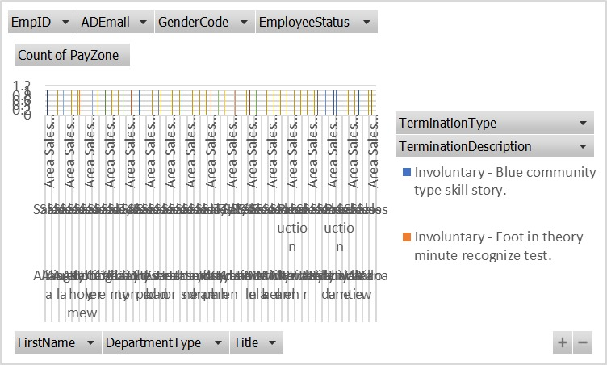
RESULTS
11

Slide 12
Conclusion Using pivot tables for employee turnover analysis offers a powerful and efficient way to gain insights from complex HR data. By summarizing and organizing data into easily understandable formats, pivot tables reveal patterns and trends in turnover rates, helping organizations pinpoint areas of concern. This analysis enables HR teams and management to make informed decisions and implement targeted strategies to address high turnover rates, ultimately leading to improved employee retention and a more stable workforce.

